Slide 1
Update from Queen’s University team in relation to research & implementation
of RSE
Professor Maria Lohan
School of Nursing & Midwifery & Centre for Evidence & Social Innovation
On behalf of the QUB Team
6 Nations RSE Symposium, October 3 2019

Slide 2
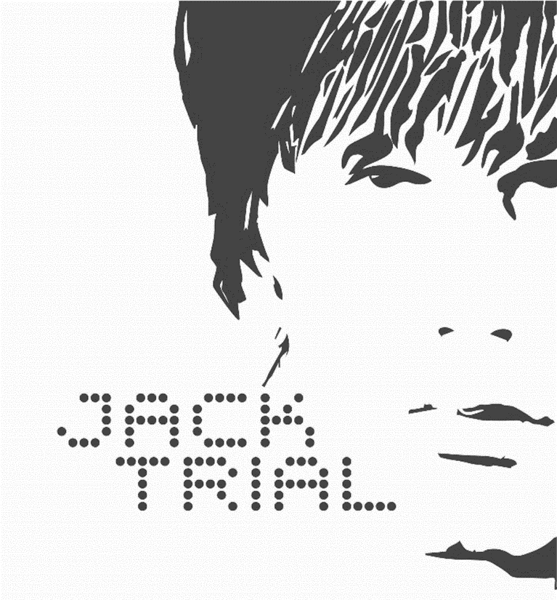
The Jack Trial
Notes:
Original films 2010
Resource materials 2012
Responding to changing RSE environment (sexual consent, sex-positive language)
Cultural and contextual adaptation (more multicultural classrooms)
Identification and engagement

Slide 3
ACKNOWLEDGEMENTS & TEAM
Queen’s University Belfast
Prof. Maria Lohan
Dr Aisling Gough
Dr Áine Aventin
Dr Theresa McShane
Prof. Mike Clarke
Dr Liam O'Hare
Cardiff University
Dr James White
Dr Honor Young
Dr Kelly Buckley
University of Glasgow
Prof. Lisa McDaid
Dr Ruth Lewis
Dr Kim Appleton
London School of Hygiene and Tropical Medicine
Dr Rebecca French
Prof. Chris Bonell
Ms. Emily Warren
University College London
Dr Julia Bailey
Dr Rachel Hunter
Northern Ireland Central Trials Unit
Ms Cliona McDowell
Funded by the NIHR Public Health Research programme (15/181/01).
The views expressed are those of the authors and not those of the NHS, the NIHR or the Department of Health

Slide 4
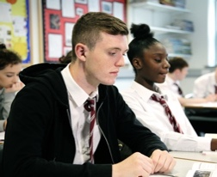
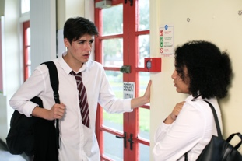
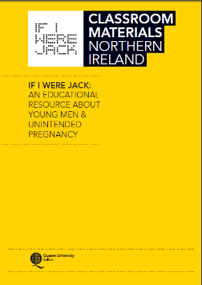
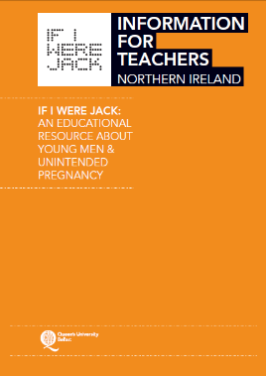
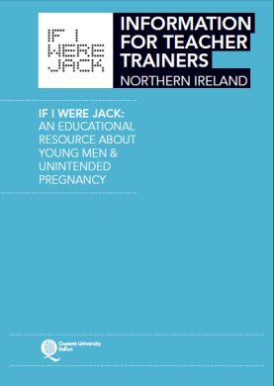
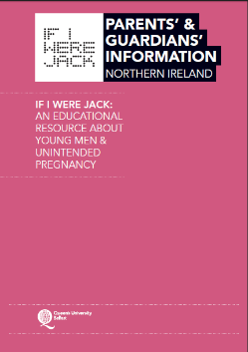
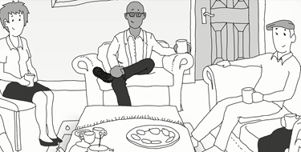
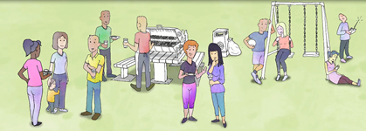
What is If I were Jack?
Interactive video film
Follow-up classroom- activities
Teacher training
Parents’ animations and parent-child homework activity
(4-6 weeks)
Notes:
The overall programme reflects a comprehensive positive approach to sexual health and well-being but designed to be flexible enough to encompass faith based messages s part of the overall information. Designed to be delivered over 4 weeks

Slide 5
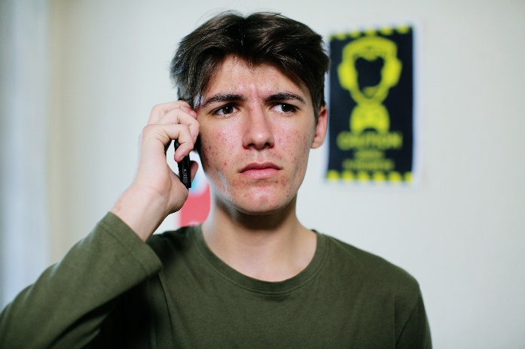
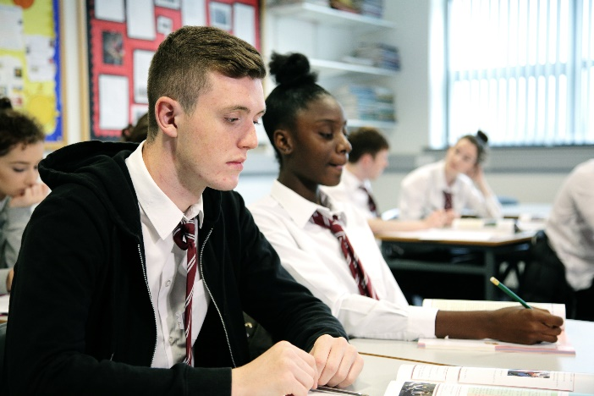
Our 3 Messages
Evidence Based Practice
Practice Based Evidence
Outcomes Focused & Logic Modelling
Notes:
Our three big messages are the importance of 1, 2, 3
But I’m sure you are already familiar with the concepts, I guess I want to show you how we think they can applied in working with adolescents for RSE
What is evidence based practice – what are the key lessons

Slide 6
JACK: Feasibility Trial Results UK (cRCT)
Acceptable
Teachers
Pupils, Parents?
Feasible
Intervention + trial methods
Transferable
Acknowledged need + fit but required cultural sensitisation
Positive outcomes
Affordable (£13.66 per pupil)
Reduction in unprotected sex at 9 mths follow up in intervention group
Notes:
Results demonstrated that the intervention was acceptable to schools, pupils and teachers, and could be feasibly implemented, cost-effectively, with minor enhancements. The between-group difference in incidence of unprotected sex (primary outcome at pupil level) of 1.3% (95% CI 0.5-2.2) by nine months demonstrated a potential effect size consistent with those reported to have had meaningful impact on teenage pregnancy.
The study responds to global health policy for a paradigm shift towards inclusion of men in the achievement of sexual and reproductive health goals in a practical way by demonstrating that a gender-sensitive as well as a gender transformative intervention targeting males to prevent teenage pregnancy is acceptable to adolescent men and women and implementable in formal education structures. If I Were Jack now merits further effectiveness testing.

Slide 7
Effectiveness Trial (underway) (Cluster)Randomised-control trial (RCT)
66 schools across the UK recruited to join The JACK Trial (completion date, Dec 2020)
33 schools were randomly allocated to the intervention group (receive the If I were Jack resource)
33 schools were randomly allocated to the control group (continue usual practice)
Data collected from pupils in all schools via a questionnaire, administered twice – once at baseline (Sept-Oct 2018) and again at follow-up (Jan-March 2020).
Process Evaluation (via a range of methods inc. semi-structured interviews/focus groups with pupils, teachers, parents and policy specialists) to examine:
Context of Participating Schools
Extant Relationship and Sexuality Education (RSE)
Fidelity to Implementation
Engagement with and acceptability of the Intervention
Future Implementation Potential
Notes:
In order to evaluate the effectiveness of the If I were Jack resource, we recruited 66 schools across the UK to join The JACK Trial (completion date, Dec 2020)
33 schools were randomly allocated to the intervention group (receive the If I were Jack resource)
33 schools were randomly allocated to the control group (continue usual practice)
Data collected from Year 11 pupils in all schools via a questionnaire, administered twice – once at baseline (Sept-Oct 2018) and again at follow-up (Jan-March 2020).
Process Evaluation (via a range of methods inc semi-structured interviews/focus groups with pupils, teachers, parents and policy specialists) to examine:
Context of Participating Schools
Extant Relationship and Sexuality Education (RSE)
Fidelity to Implementation
Engagement with the Intervention
Intervention Acceptability
Future Implementation Potential

Slide 8
Some Results from the Process Evaluation: Intervention Acceptability
IVD positively received
Male role (gap filled)
Activities perceived as relevant
‘Off the shelf’ resource
‘It’s good … It makes you aware … I don’t think having a baby would tie in with your schoolwork very much, you know, too much stress from school and from waking up late at night, to change nappies and all’ (Male pupil).
‘[My friends] were shy to talk about it at first … After the video, they were more confident, so that was good’ [Pupil]
‘It’s opened how girls think about boys, because boys keep [their feelings] to themselves]. Well, whenever Jack was talking about Emma, it makes girls more aware that the boy actually does go through stuff and they just don’t know how to deal with it’.
[Female Pupil].
‘Brilliant!’ … ‘Perfect!’ … ‘Fully planned lesson resources … Much better than anything else I’ve seen!’ [Teachers]
Notes:
IVD positively received by teachers and pupils. Pupils generally found the actors relatable and thought Jack and Emma’s story was believable (some evidence also contrary to this but in the main it was positive). In particular, boys enjoyed the fact that it was about them. Some girls in focus groups however thought it was too one-sided (I.e., focusing on boys too much so not all that relevant to them)
Teachers overwhelmingly positive about this ‘off the shelf resource’ complete with classroom activities, evidence based factual information and quality teacher training and support.
Student Engagement Qs not yet analysed Maria, but these are the initial themes from pupil focus groups, observations and teacher interviews.

Slide 9
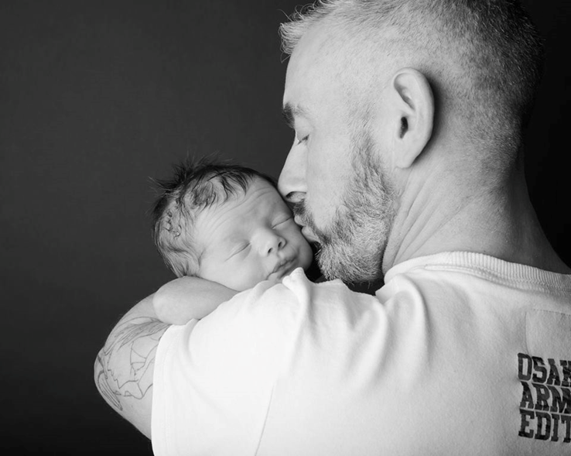
RELATIONSHIPS AND FUTURE FATHERHOOD
If I Were a Dad Programme
RFF - This work was supported by the Medical Research Council [grant number: MR/RO14450/1]
Notes:
i) Understanding gender, sex & relationships
ii) Sexual health knowledge
iii) Communication & relationship skills - negotiating
consensual sex
iv) Impact of extended family structures & social services
involvement
v) Mental health, alcohol and drugs awareness
vi) Positive male role models & responsibility
vi) Shared/ co-parenting

Slide 10
Interventions addressing men, masculinities and gender equality in sexual and reproductive health:
An evidence and gap map and systematic review of reviews
Based on Paper accepted in BMJ Global Health August 2019 DOI: 10.1136/bmjgh-2019-001634, Full Text

Slide 11
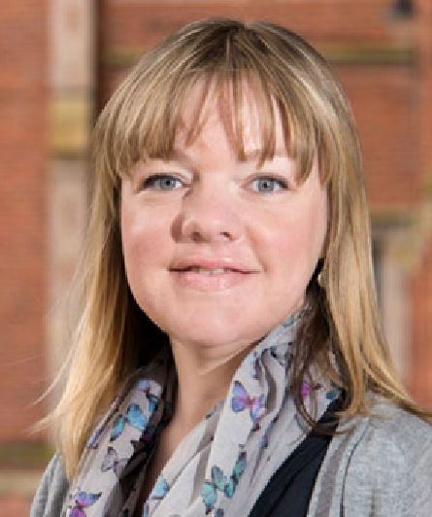
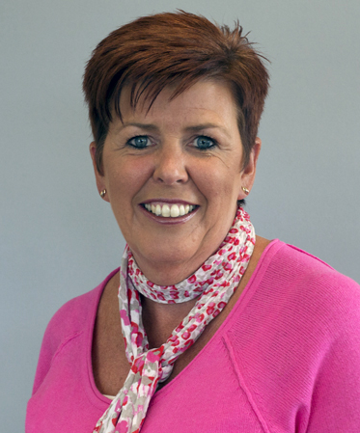
Our Team
Dr Eimear
Ruane-McAteer
QUB
Dr Avni Amin
WHO
Dr Jennifer Hanratty
QUB
Dr Fiona Lynn
QUB
Dr Kyrsten Corbijn
van Willenswaard
QUB
Dr Esther Reid
QUB
Rajat Khosla
WHO
Professor Maria Lohan
QUB

Slide 12
Why this review?
25 years on form the Cairo conference
Assessment of evidence needed on how best to engage men and boys to address gender inequality and improve SRHR
Interventions that address gender inequality in health programming have become known as ‘Gender Transformative’

Slide 13
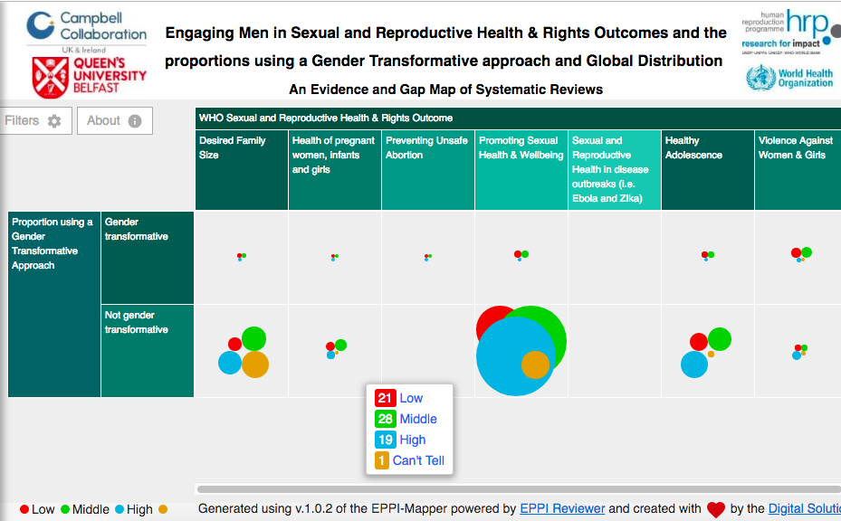
Evidence and Gap Map
Gender Transformative and Country Income Breakdown
Link to EGM (Geographic Spread)

Slide 14
We welcome your thoughts and feedback
Thank you.
Interventions addressing men, masculinities and gender equality in sexual and reproductive health and rights: an evidence and gap map and systematic review of reviews
DOI: 10.1136/bmjgh-2019-001634, Full Text

